Slide 1
Integrating Ethics into K12 AI Education
Tom Yeh, Matthew Turner, Bridget Dalton, Eleanor Haberl, Stacey Forsyth
University of Colorado Boulder

Slide 2
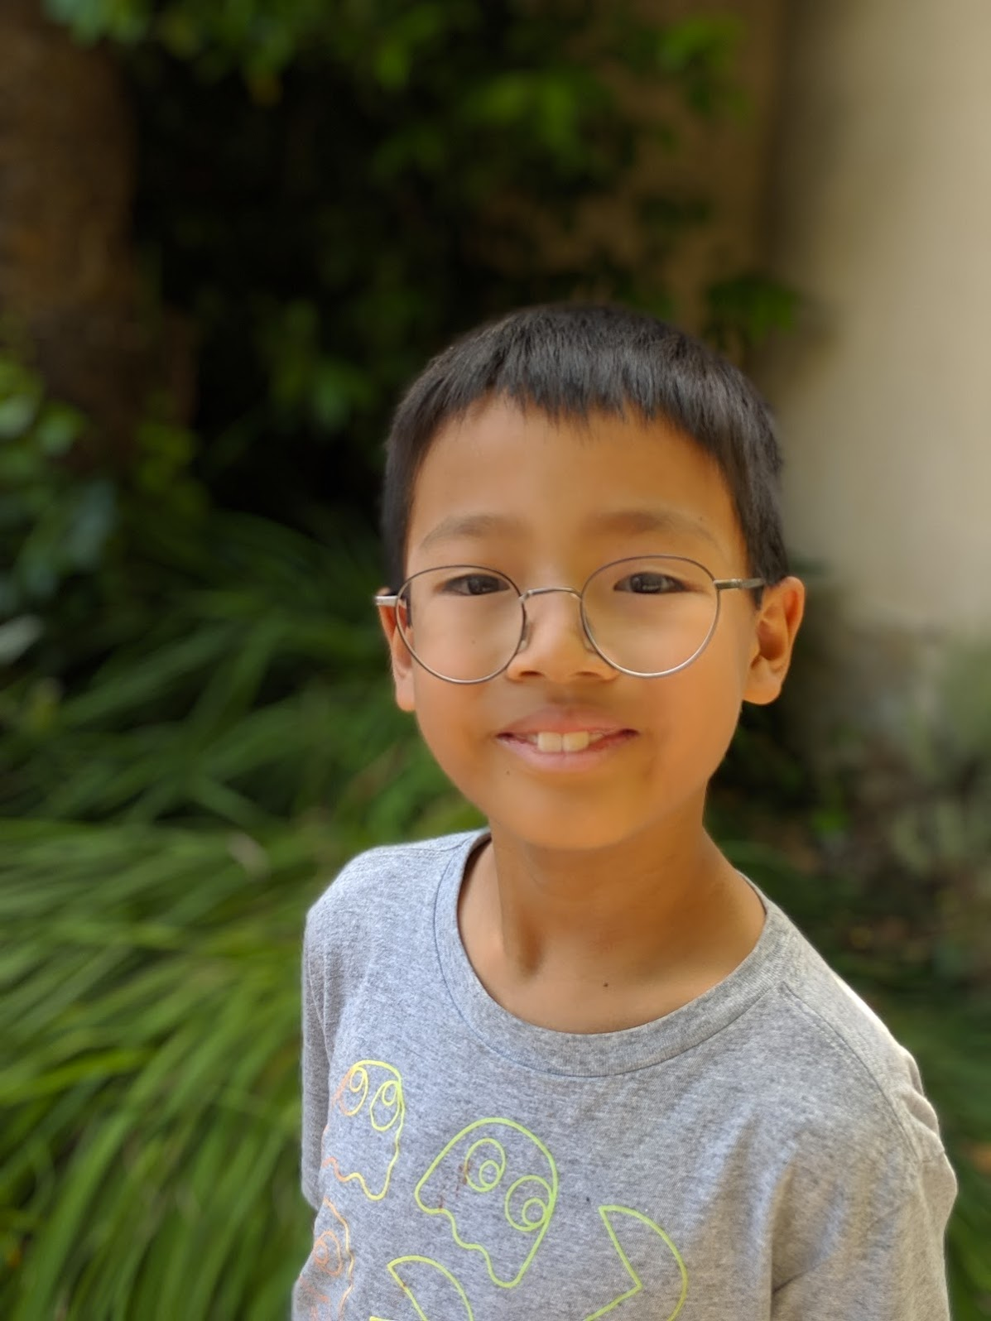
As a parent, what should I tell my son about AI?

Slide 3
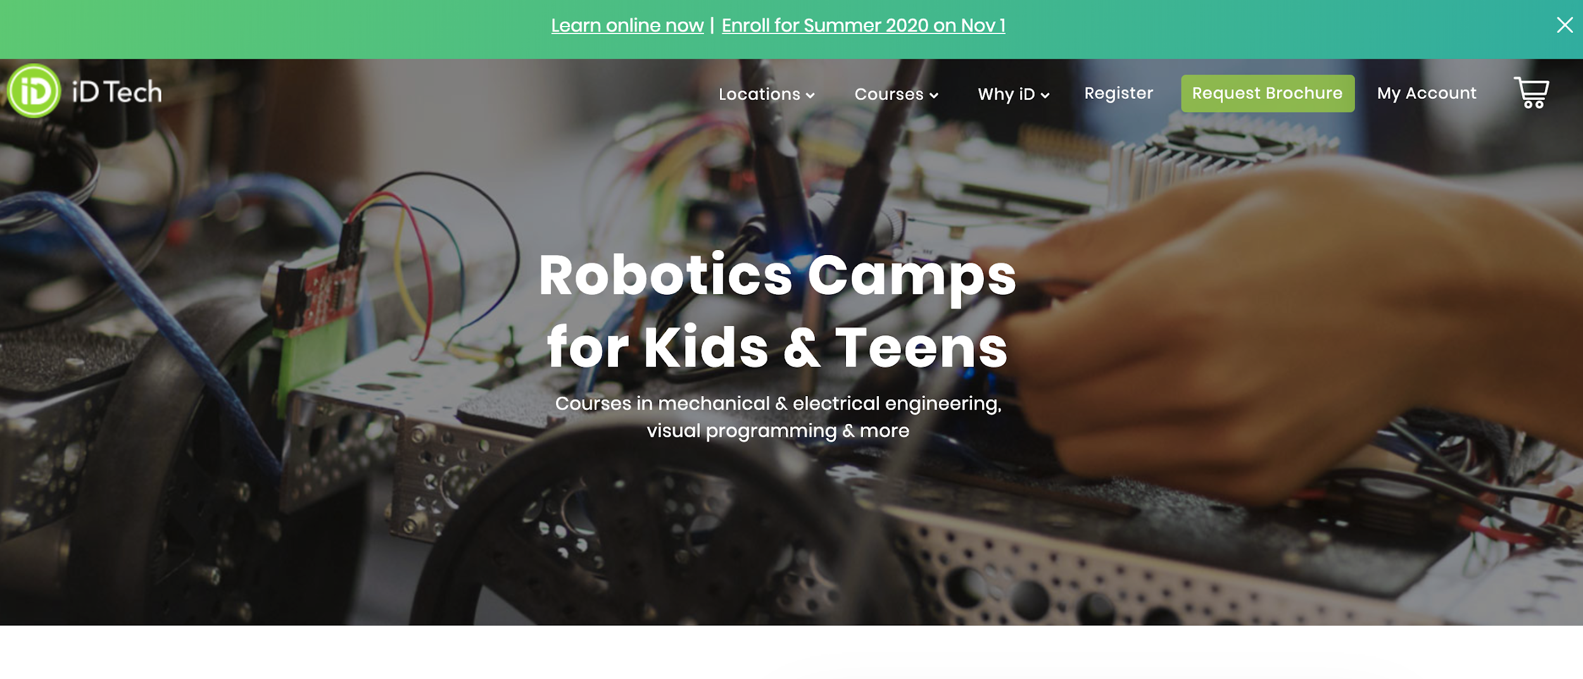
What should my son do this summer?

Slide 4
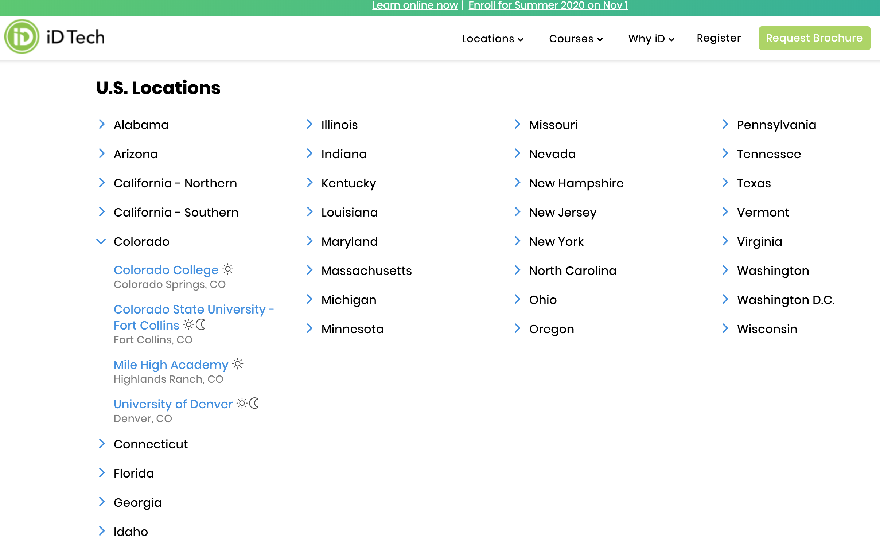

Slide 5
How many also teach ethics?
>80%

Slide 6
How many also teach ethics?
>80% 🡨 dream
<5% 🡨 reality

Slide 7
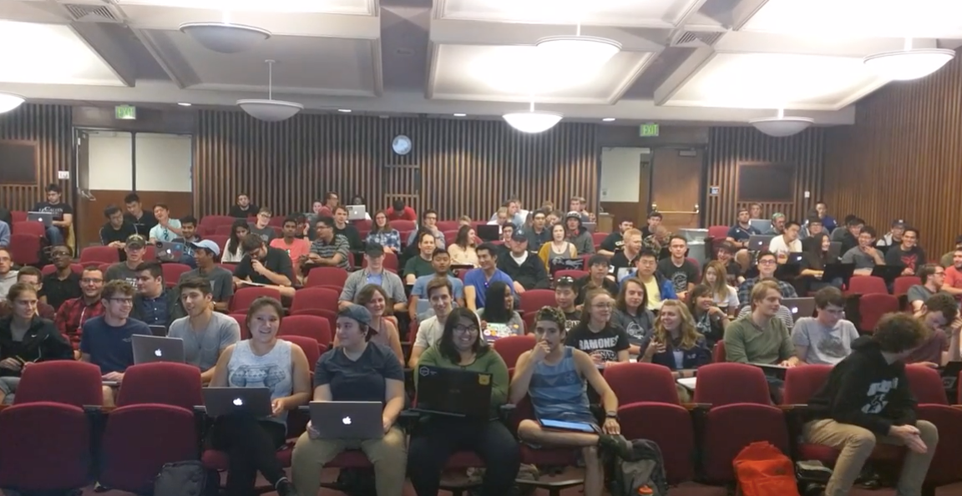
As a professor, what is my responsibility for these college students?

Slide 8
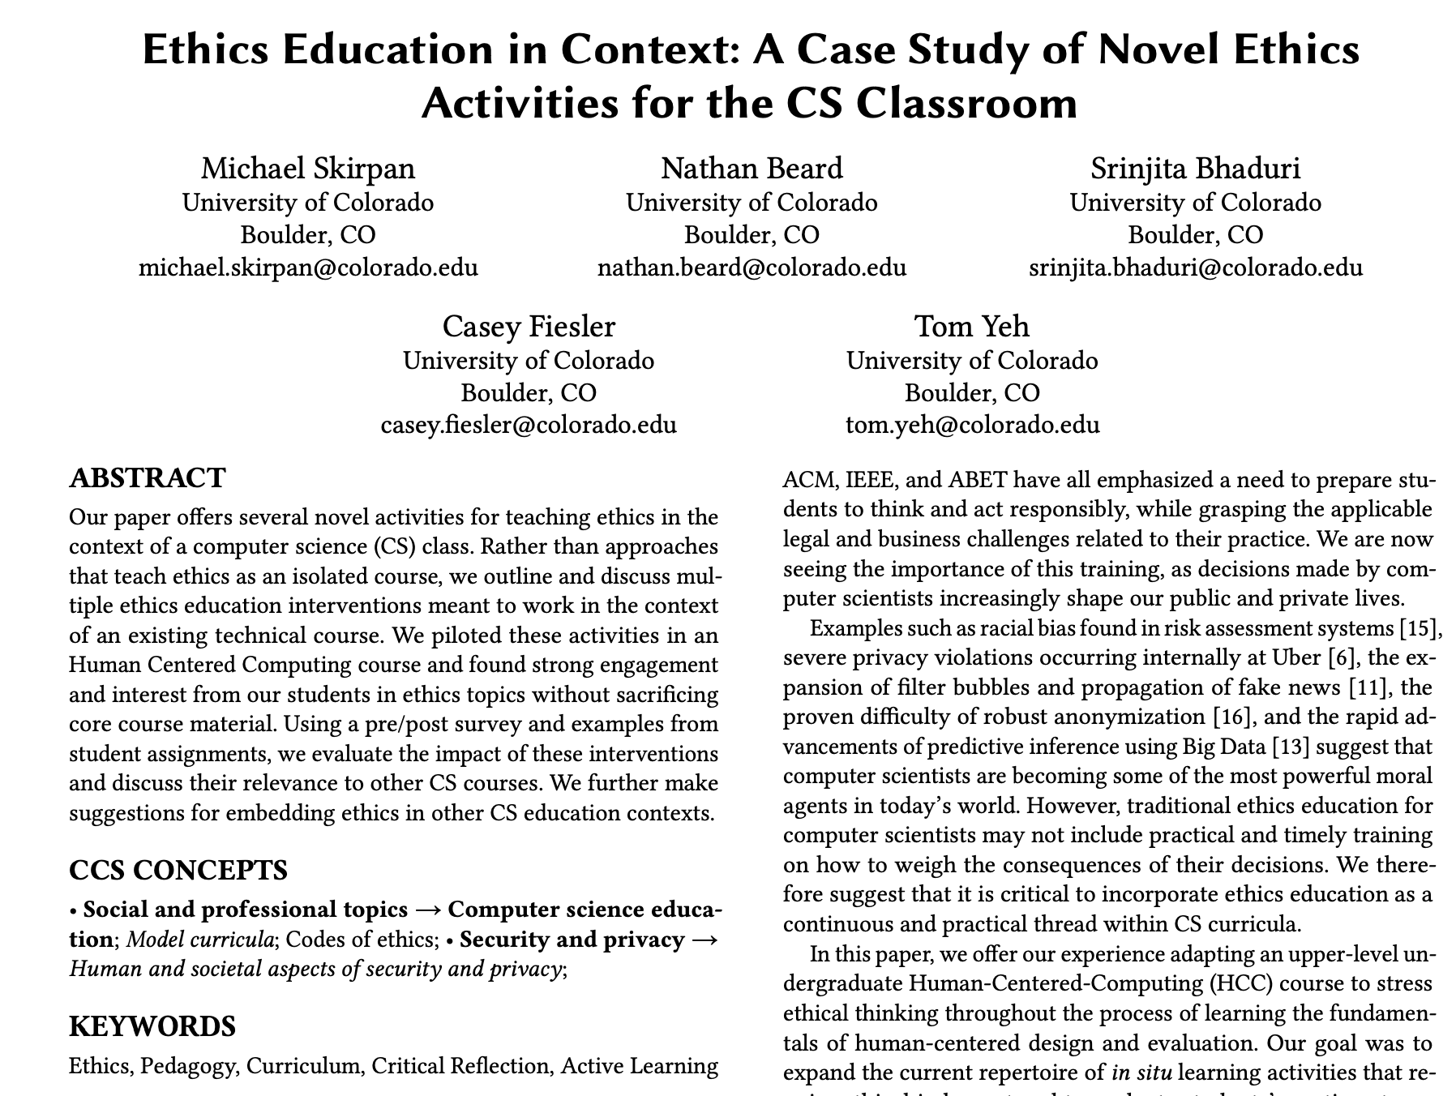
Michael Skirpan, Nathan Beard, Srinjita Bhaduri, Casey Fiesler, and Tom Yeh. 2018. Ethics Education in Context: A Case Study of Novel Ethics Activities for the CS Classroom. In Proceedings of the 49th ACM Technical Symposium on Computer Science Education (SIGCSE '18). Third Best Paper Award

Slide 9
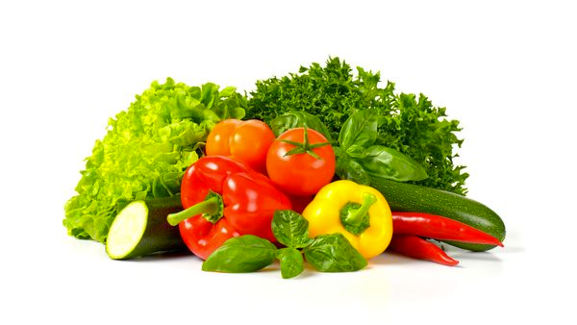
Takeaway 1: If AI is Meat, Ethics is like Vegetables.

Slide 10
Key strategies to teach AI ethics to K12
Continuous
Integrated
Translated
So that our students will eat that vegetables.

Slide 11
Apple Problem
1
Let’s do some simple math

Slide 12


Let’s distribute 12 apple to 4 children

Slide 13
Easy! Each child gets 3 apples.

Slide 14
But, have you considered
Why evenly?
Why apples?
Why 4 children?
Math is more than just 12 divided by 4.
AI is more than just deciding how to distribute 12 objects to 4 people.

Slide 18
Imperfect Match
2
Let’s find a perfect pet for each family

Slide 19
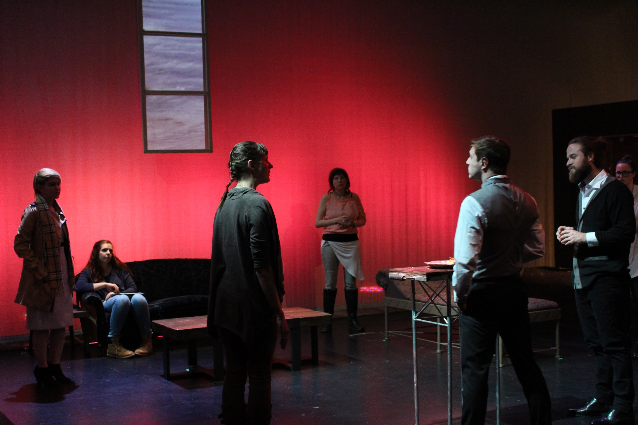
Actor
Actor
Actor
Actor
Actor
YOU

Slide 20
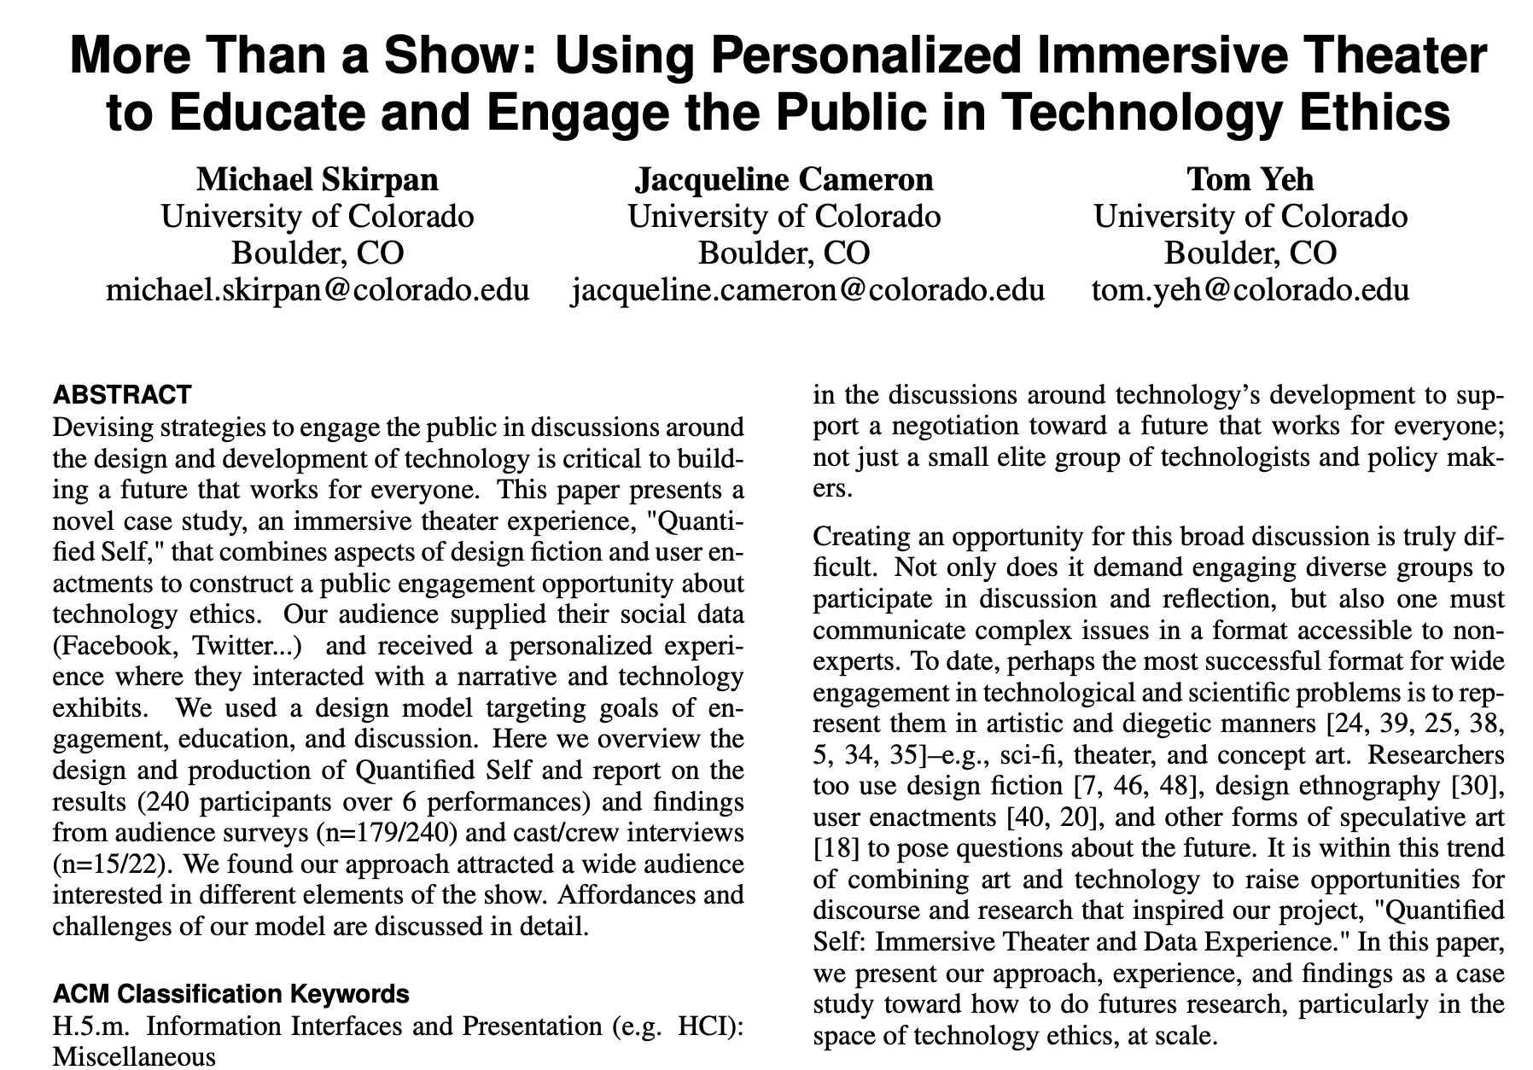
Michael Skirpan, Jacqueline Cameron, and Tom Yeh. 2018. More Than a Show: Using Personalized Immersive Theater to Educate and Engage the Public in Technology Ethics. In Proceedings of the 2018 CHI Conference on Human Factors in Computing Systems (CHI '18).

Slide 21
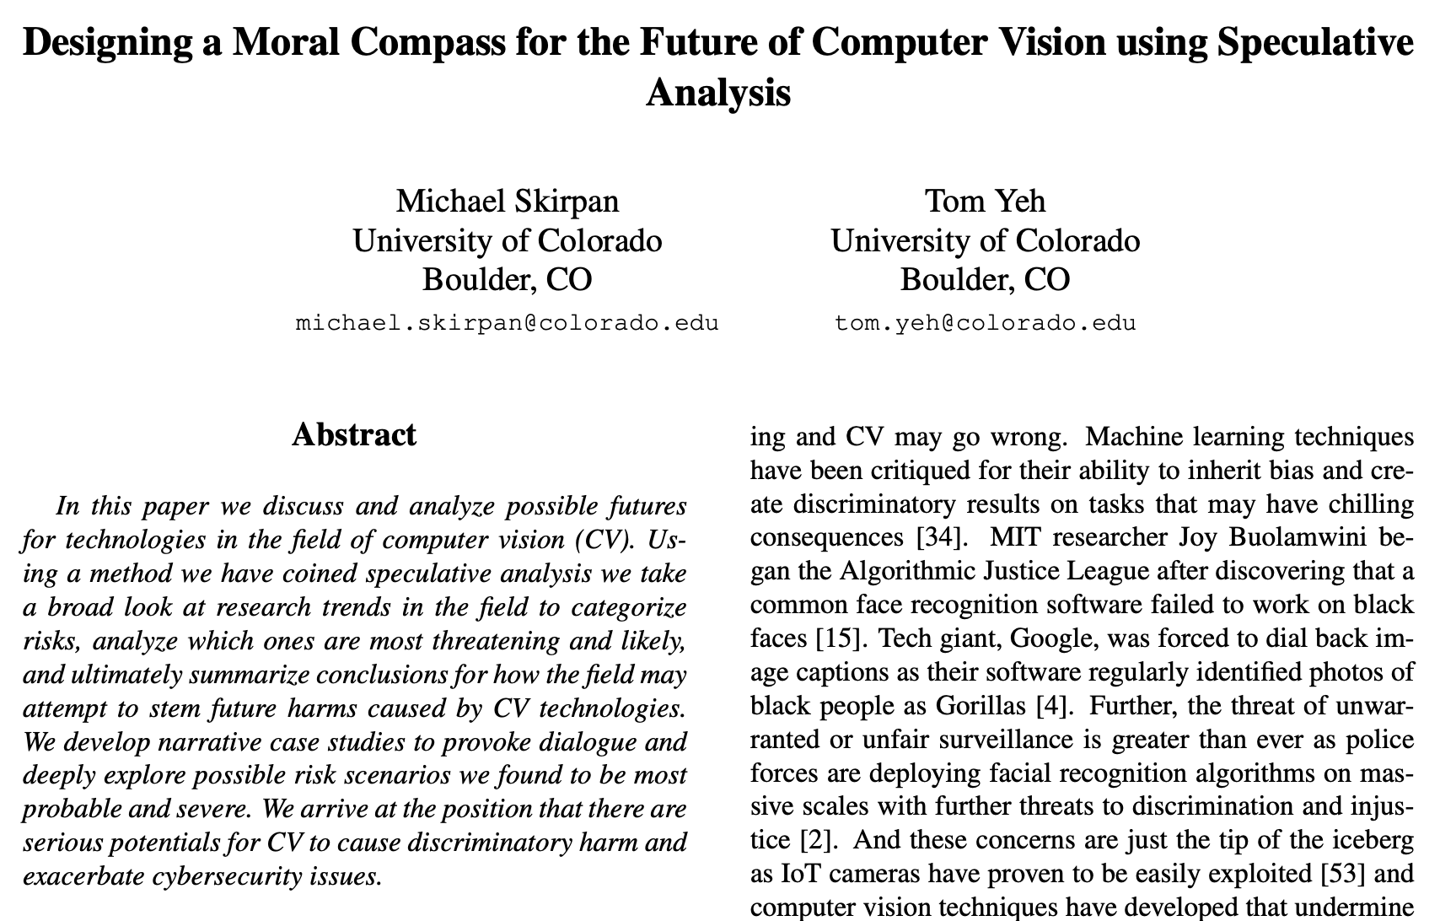
Mike Skirpan and Tom Yeh, Designing a Moral Compass for the Future of Computer Vision Using Speculative Analysis, In Proceedings of the 2017 IEEE Conference on Computer Vision and Pattern Recognition Workshops.

Slide 22
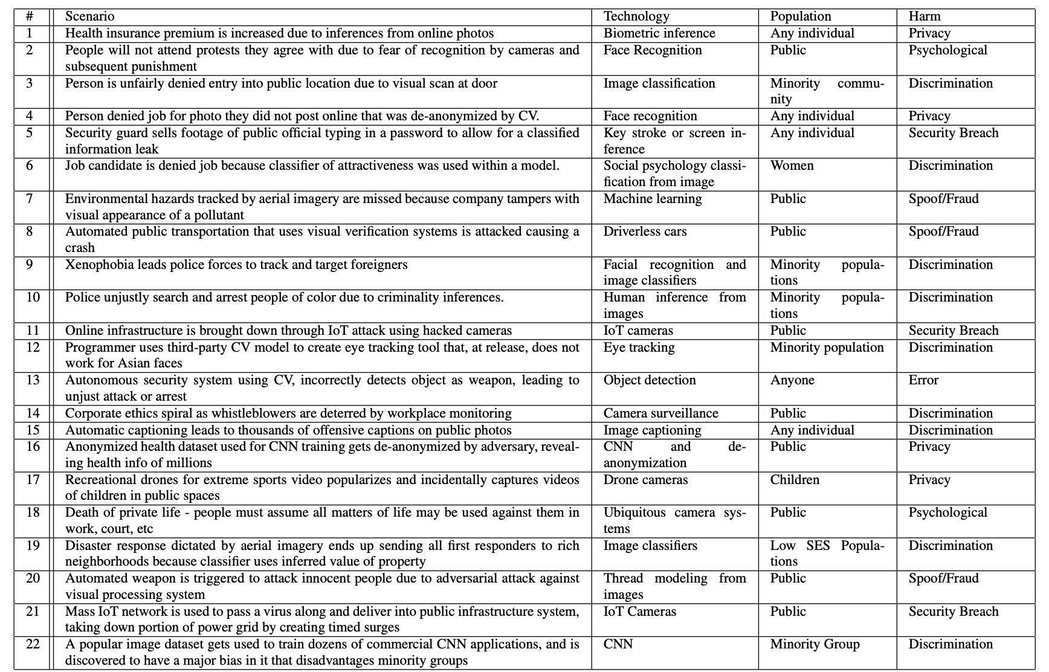
We identified 22 risk scenarios involving computer vision technology.

Slide 23
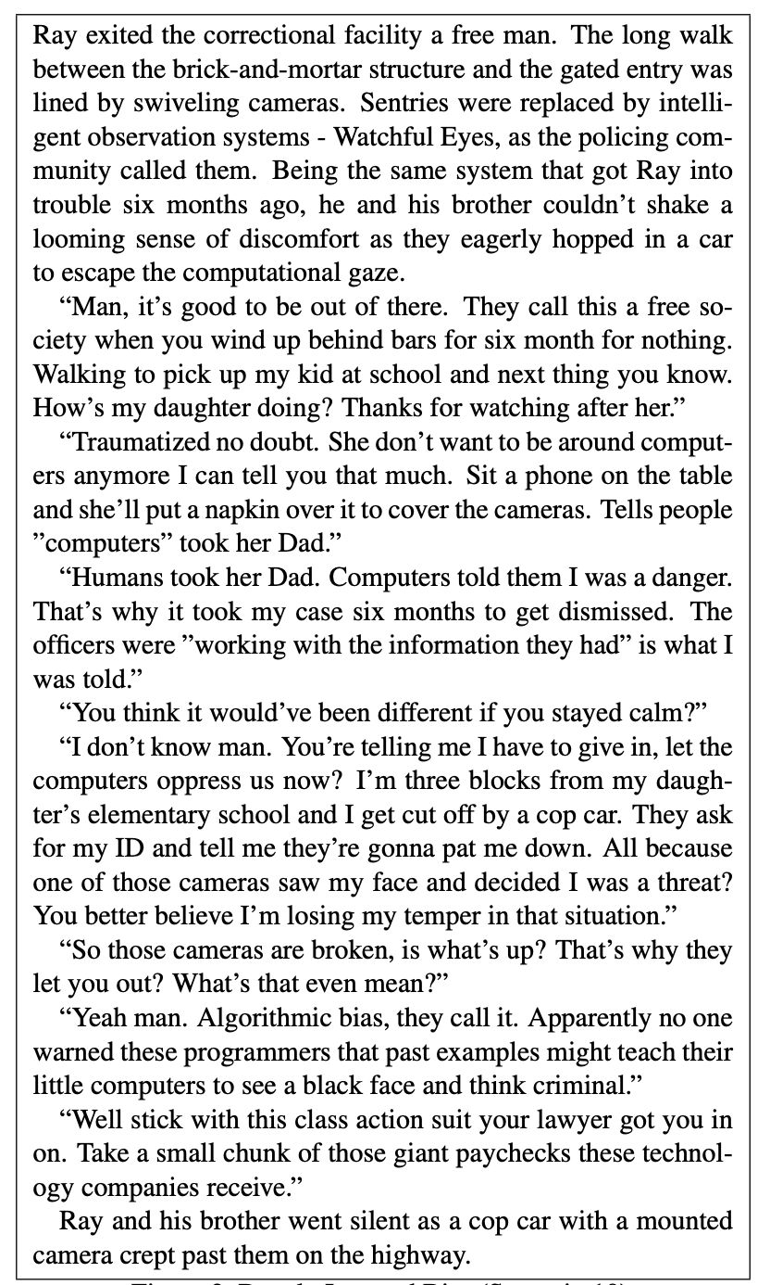
“How’s my daughter doing? Thanks for watching after her.”
“Traumatized no doubt. She don’t want to be around computers anymore I can tell you that much. Sit a phone on the table and she’ll put a napkin over it to cover the cameras. Tells people ”computers” took her Dad.”

Slide 24
Our Story Writing Team
Eleanor Haberl: PhD student, Education, story writing
Bridget Dalton: Professor, Education, Literacy Studies
Tom Yeh: Professor, Computer Science, Human Computer Interaction
Matthew Turner: Secondary school STEM teacher

Slide 25
Plot
Lucy works in a pet adoption facility
Lucy’s boss introduces an AI pet matcher
Lucy is noticing something weird…

Slide 26
Excerpts
But, inside, Lucy was just angry. Lucy had been working at the pet adoption shelter all summer. And she was starting to see a trend. As she handed the blue file to the children, she wondered to herself “Another golden retriever?”
…….
Lucy was thinking about the first time she held her dog, Mac. She couldn’t imagine the model would be able to predict the loving connection she felt.
…….
Now Mac was curled up in Lucy’s lap. It made her so angry to imagine that she wouldn’t have been matched with him.

Slide 27
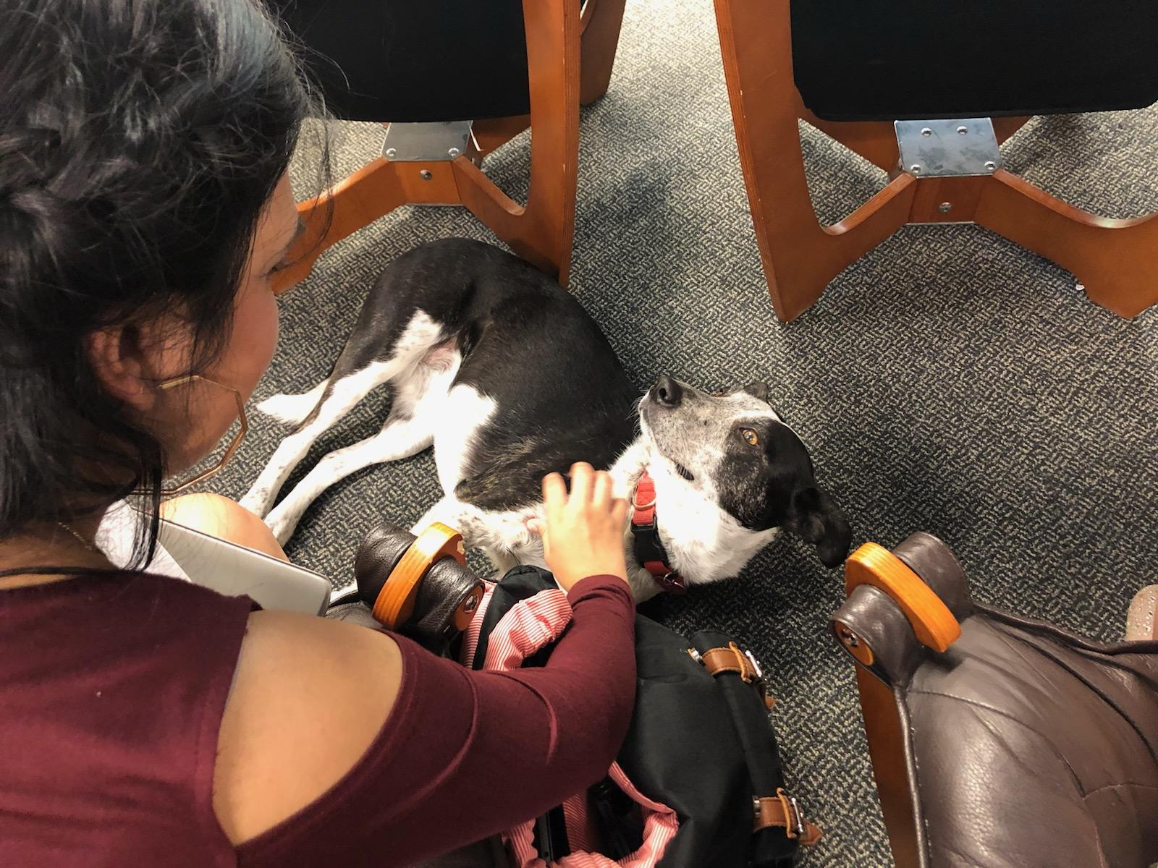

Slide 28
Students wrote down the breeds of dogs they have
Latino | Asian | Caucasian | Other

Slide 29
Students wrote the size of their family
2 | 3 | 4 | 5 | 6 | 7 | 8 | 9

Slide 30
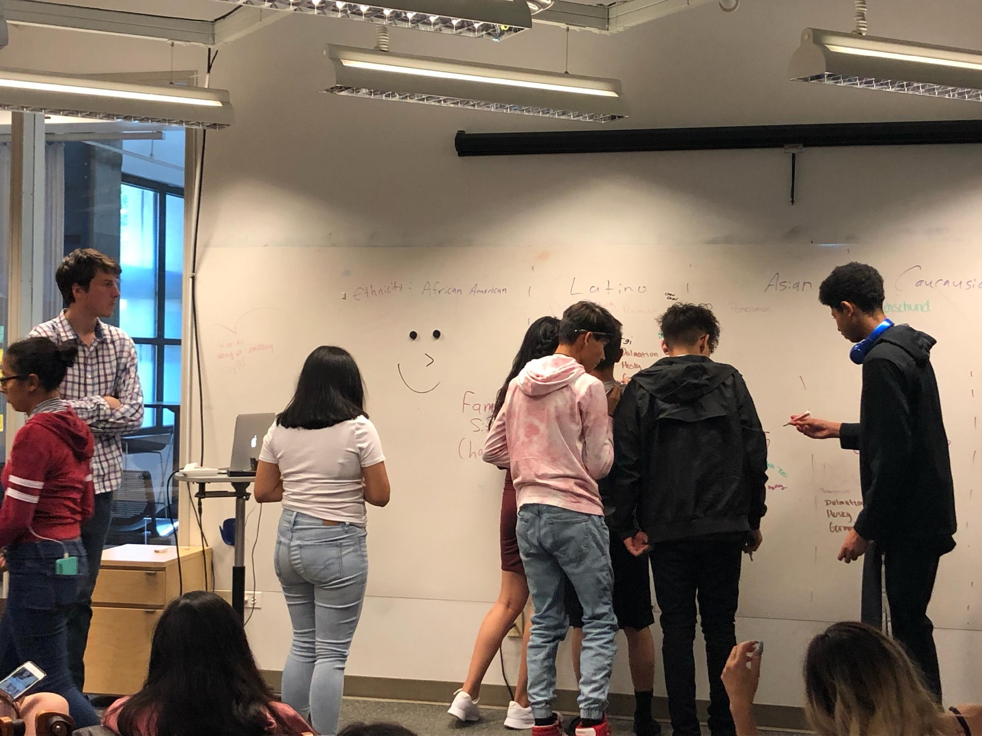

Slide 31
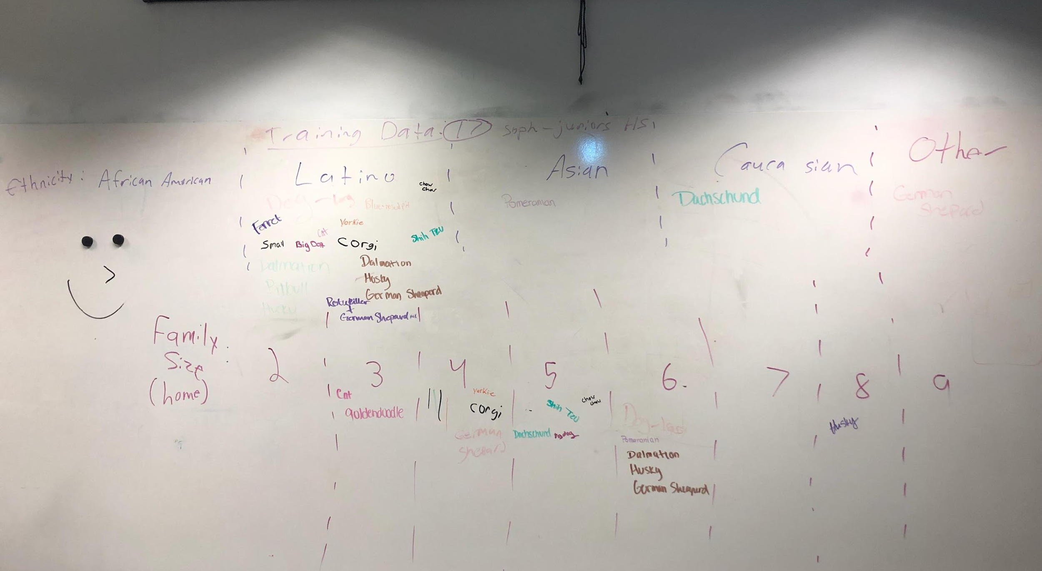

Slide 32
Does this story remind you of other uses of AI?
“Social media tracks things and suggest things even though you might’ve only liked a thing once”
“Ads for a product that you may not even want.”

Slide 33
Why is Lucy upset?
“System is unfair”
“Data is biased”
“Because not every dog gets the same chance”
”Because if it wasn’t for meeting her dog [Max] in person, she wouldn’t be able to love it as much as she does”

Slide 34
More stories under development
AI’s bias in choosing a desired role/job/scholarship/opportunity
Dystopic context with high stakes for survival
Alexa’s role in recommending music that gradually changes someone’s taste
AI’s role in criminal justice to explore the tradeoff between public safety and fairness.

